Slide 1

Building Movies Search app using React Native
Ronald Kasendwa,
Head of Mobile & USSD,
Eversend

Slide 2
What is Eversend?

Slide 3
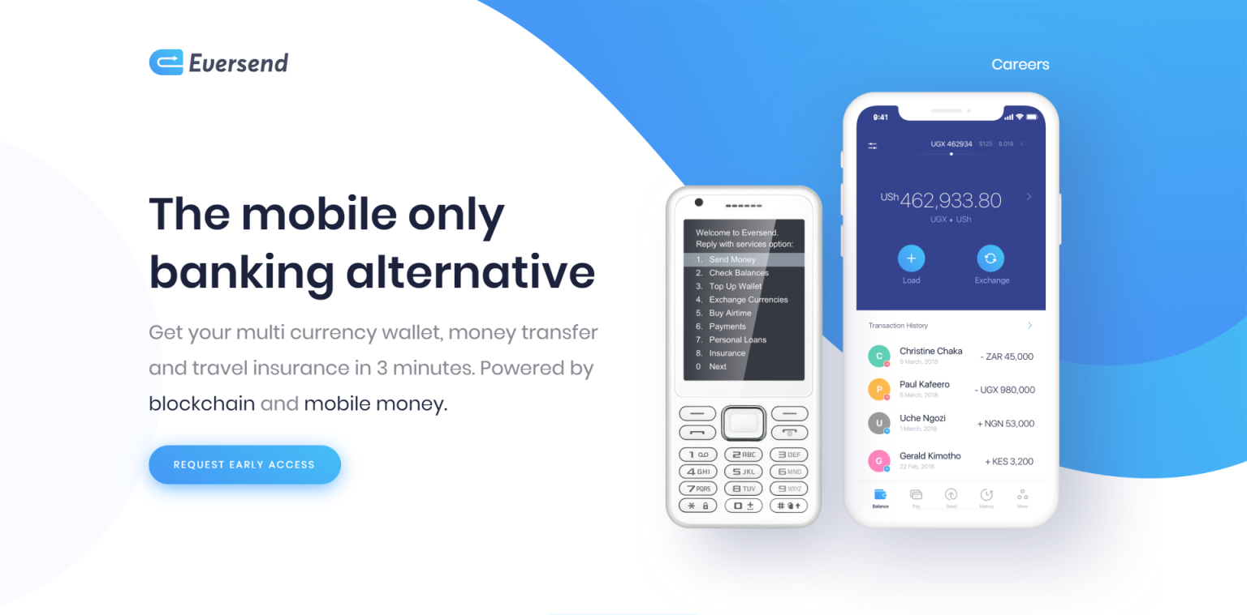

Slide 4
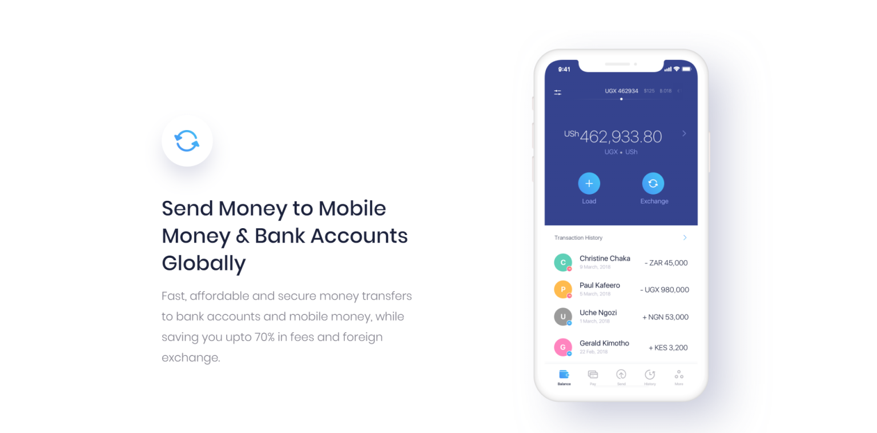

Slide 5
Request early access at
https://eversend.co

Slide 6
What is Movie Search?

Slide 7
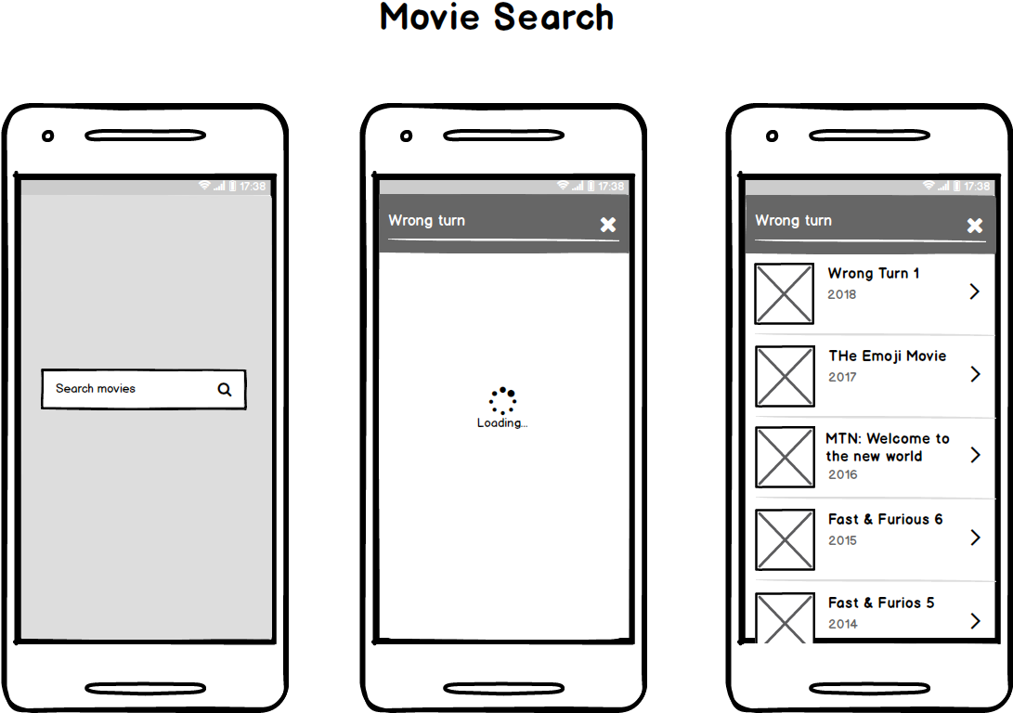

Slide 8
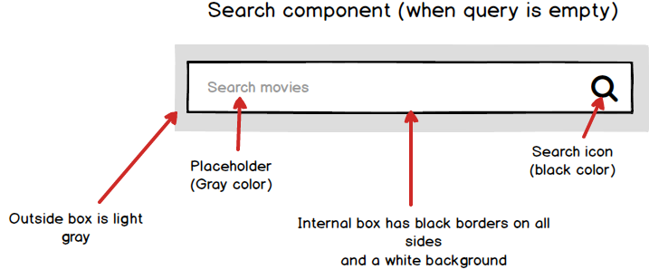

Slide 9
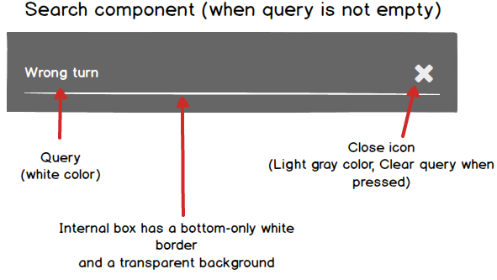

Slide 10
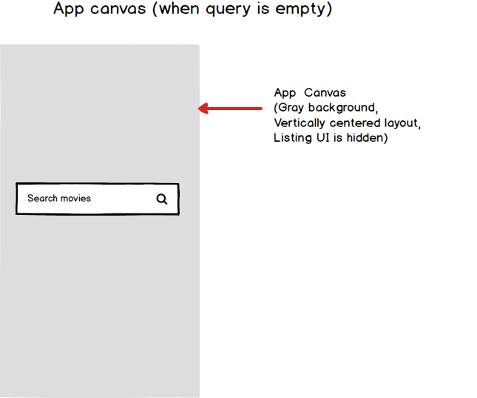

Slide 11
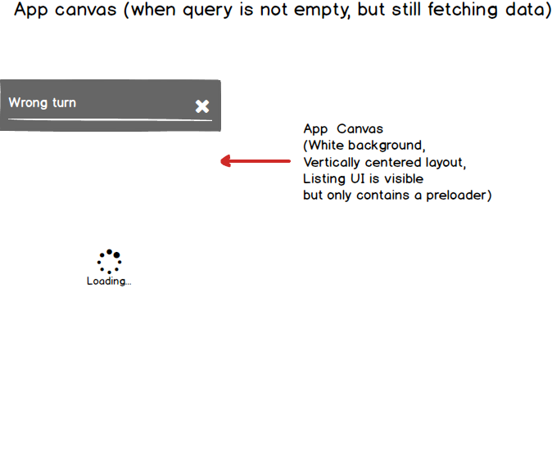

Slide 12
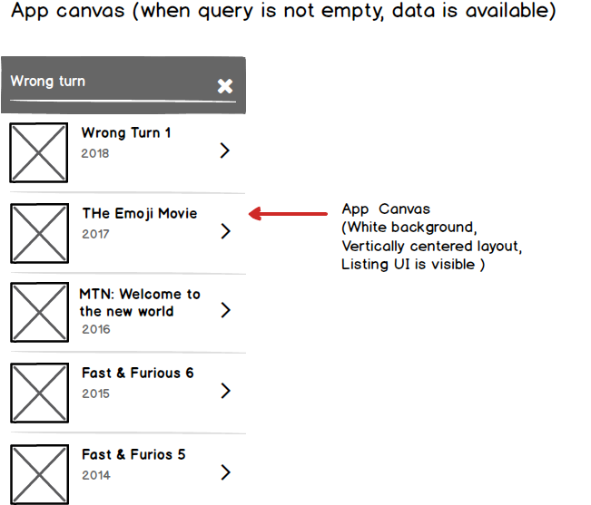

Slide 13
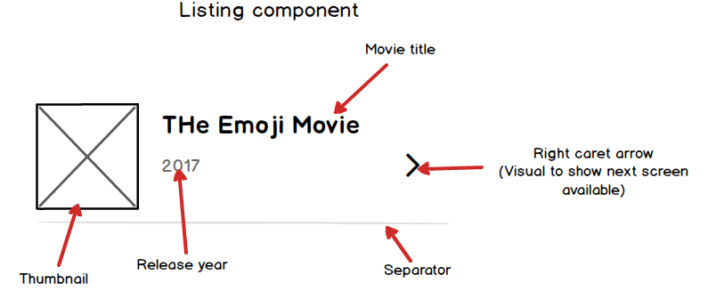

Slide 14
